Slide 1
Employee Management System

Slide 2
Team TED
Team Members:
Astitva Vimal
Vishnu Priya
Nilesh Bind
Padma Sree
Prudhvi

Slide 3
Introduction
Employees are the backbone of any company therefore their management plays a major role in deciding the success of an organization. Employees Management Software makes it easy for the employer to keep track of all records. This software allows the administrator to edit employees, add new employees, and terminate employees. Each employee in the database is associated with a position can be added and edited when need arises.

Slide 4
Problem Statement
Manual handling of employee information poses a number of challenges. The use of paper work in handling some of these processes could lead to human error, papers may end up in the wrong hands and not forgetting the fact that this is time consuming.
This system will maintain employee information in a database by fully privacy and authority access. The project is aimed at setting up employee information system about the status of the employee, the educational background and the work experience in order to help monitor the performance and achievements of the employee through a password protected system.

Slide 5
Objectives
The objective of this project is to provide a comprehensive approach towards the management of employee information. This will be done by designing and implementing an Employee management system that will bring up a major paradigm shift in the way that employee information is handled.
The objectives of this system include:
Design of a Employee management system to fulfill requirements of an administrator and an employee.
Well-designed database to store employee information allowing the administrator to edit employees, add new employees, and terminate employees.

Slide 6
Scope
The scope of this project will be limited to the following:
Employee profiles:
Employees will have access to their personal profiles.
Admin will have access to all the employee details
Admin will be able to perform operations like adding an employee, updating the details of an employee, deleting an employee details.

Slide 7
REQUIREMENTS AND CONSTRAINTS

Slide 8
Functional Requirements:
Authentication
Login- The user can login to the Employee system with his/her username and password.
Logout- The user can log out from the Employee system.
Login failure- If the user does not exist in the database.
Authorization
User role check- After logging in, the user role will be checked from the database and will be displayed accordingly.

Slide 9
Functional Requirements:
Process Data
Display- User with defined roles can display the content of the database. Being more specific, employee can only view his/her personal information. Admin can display the personal information and all employees’ information and modify them.
Edit- Admin can edit all information related to all employees’ including their user role type.
Recruitment
Add new employee- Admin role type is able to add a new employee to the database. The new employee will have all the required information related to him/her. The new created employee will have a unique id.
Add a new user- After a new employee has being created, admin role is responsible for creating a new user by the specified id assigned in the “Add a new employee” feature. The unique id will be given by the system

Slide 10
Non-Functional Requirements:
Performance requirements
There is no restriction on the number of the users to be added to the database.
Hardware requirements
EMS should be able to work on a computer with the following minimum hardware specifications:
OS: Windows XP/Vista/7/8 and Linux
CPU: Pentium III (700MHz) and above
Memory: 128 MB and above
Capacity: 4GB of hard drive
Others: Mouse, keyboard, and monitor.
Software requirements
The EMS software personal database model will support MySQL environment as DBMS.

Slide 11
SOFTWARE METHODOLOGIES
The Waterfall Model
The waterfall model is a sequential design process, often used in software development processes. It takes the fundamental process activities of specification, development, validation, and evolution and represents them as separate process phases such as requirements specification, software design, implementation, testing, and so on.

Slide 12
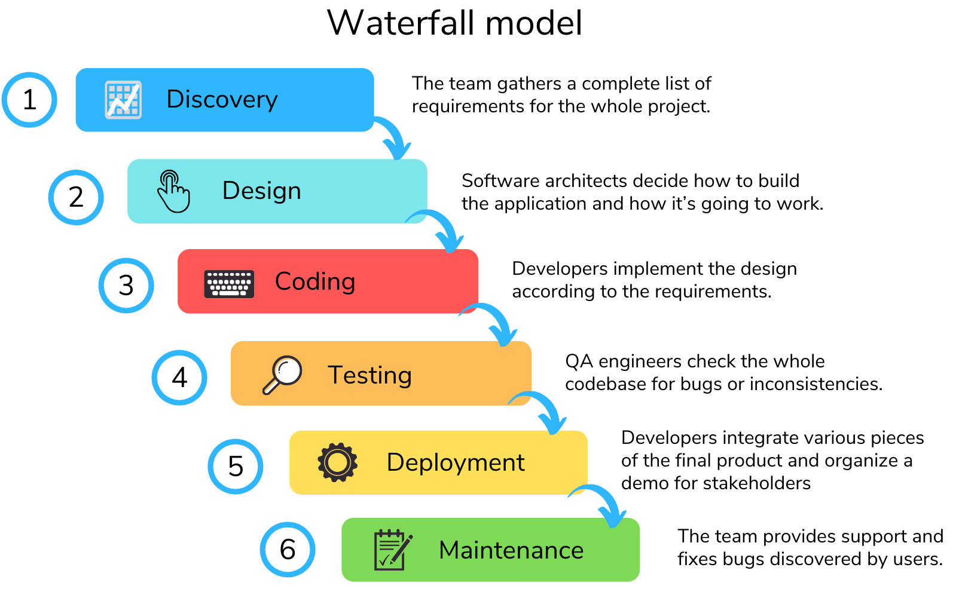

Slide 13
DEVELOPMENT TOOLS AND SOFTWARE TO BE USED

Slide 14
Back-end Technology Java Java is a high-level, class-based, object-oriented programming language that is designed to have as few implementation dependencies as possible. It is a general-purpose programming language intended to let programmers write once, run anywhere (WORA), meaning that compiled Java code can run on all platforms that support Java without the need for recompilation. Java applications are typically compiled to bytecode.

Slide 15
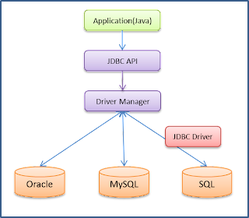

Slide 16
Database Management System MySQL MySQL is an open source database that is platform independent and can easily interface with a number of scripting languages, it works best with PHP though. The number of advantages of using MySQL which include, the ability to handle stored procedures, triggers, SQL and User-Defined functions. It also offers a high-speed data load utility and support for various drivers (ODBC, JDBC, .NET, PHP).

Slide 17
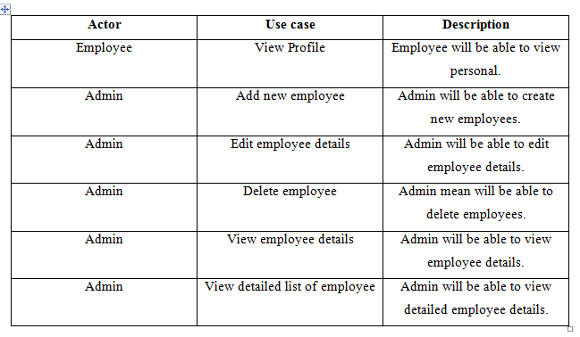
SYSTEM DESIGN
Use case analysis

Slide 18
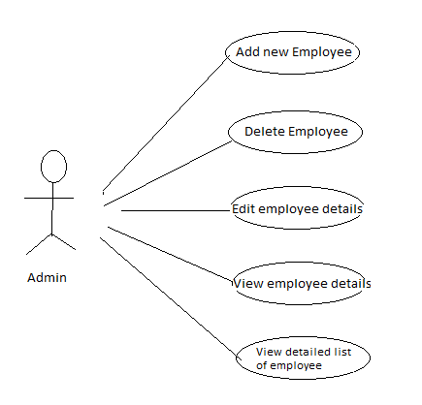
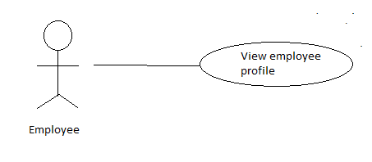
Use Case diagram

Slide 19
Testing and Verification
SCOPE
The overall purpose of testing is to ensure the Employee Management System meets all of its functional and business requirements.
TESTING GOALS
The goals in testing this system include validating the quality, usability, reliability and performance of the application. Testing will be performed from a black-box approach.
MANUAL TESTING
Manual Testing is a type of software testing in which test cases are executed manually by a tester without using any automated tools. The purpose of Manual Testing is to identify the bugs, issues, and defects in the software application. Manual software testing is the most primitive technique of all testing types and it helps to find critical bugs in the software application.
REGRESSION TESTING
The purpose of a regression testing is to verify that modifications in the software or the environment have not caused any unintended adverse side effects and that the system still meets its requirements

Slide 20
Project Walkthrough

Slide 21
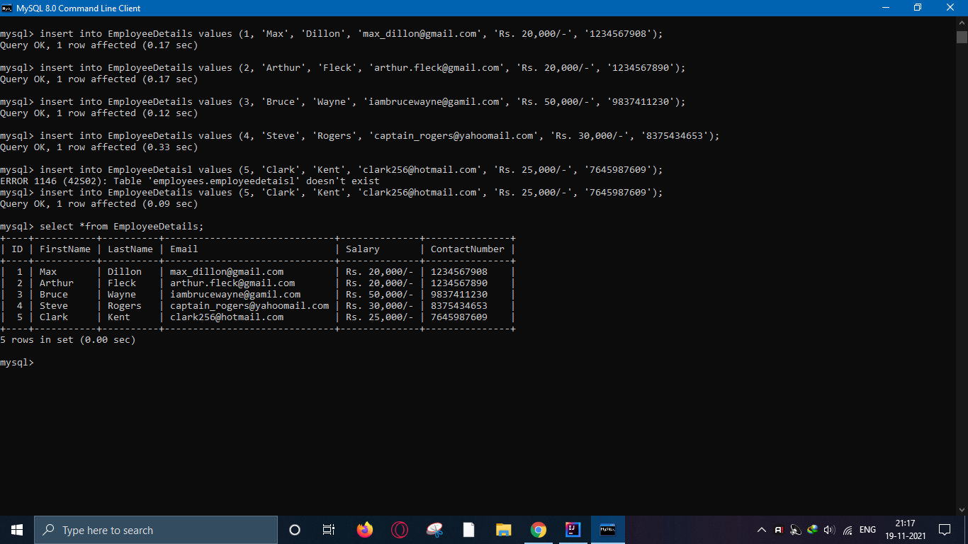
Database Creation

Slide 22
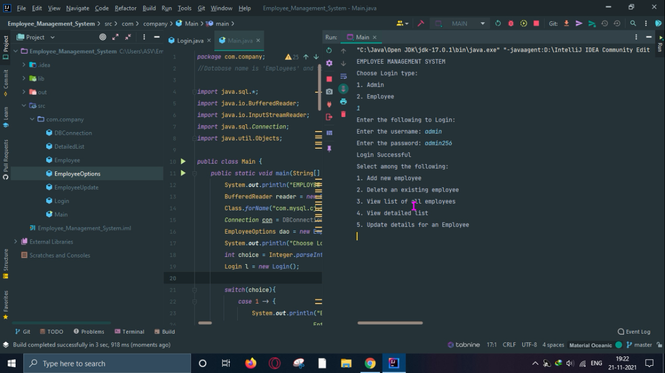
Employee Management System
Admin Login:

Slide 23
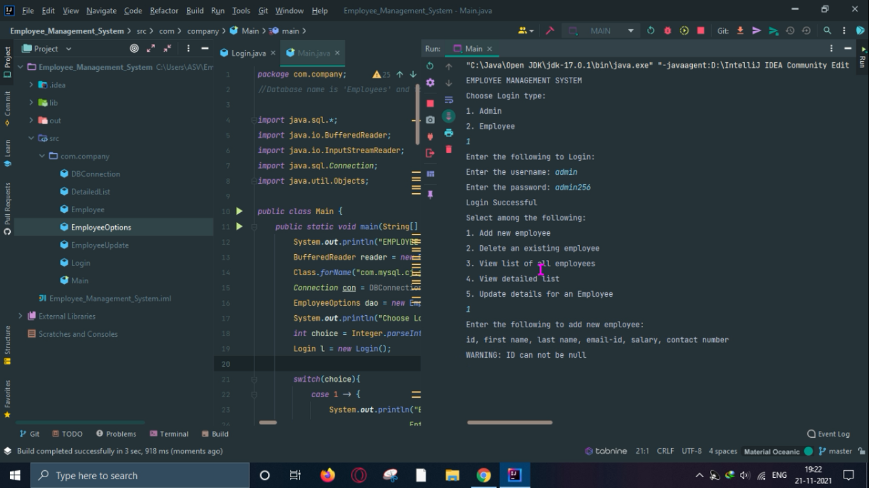
Employee Management System
Add new Employee

Slide 24
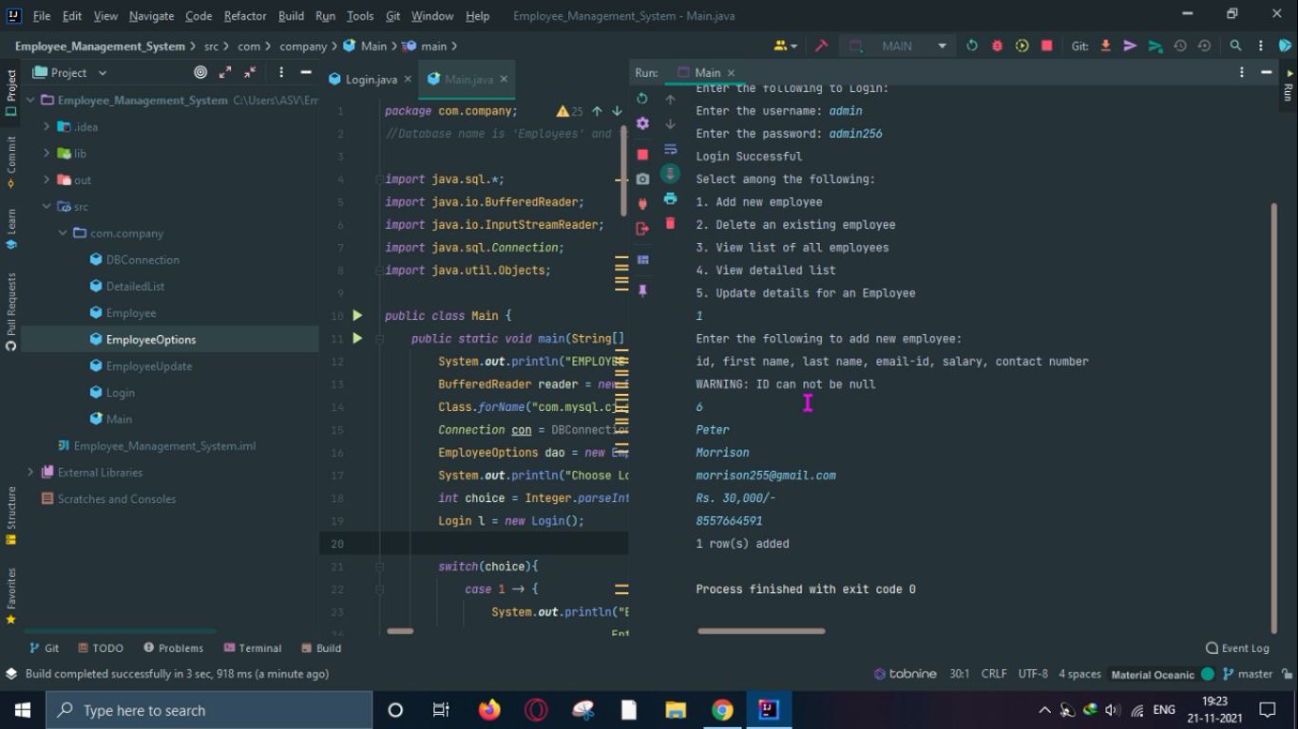
Employee Management System
Add new Employee

Slide 25
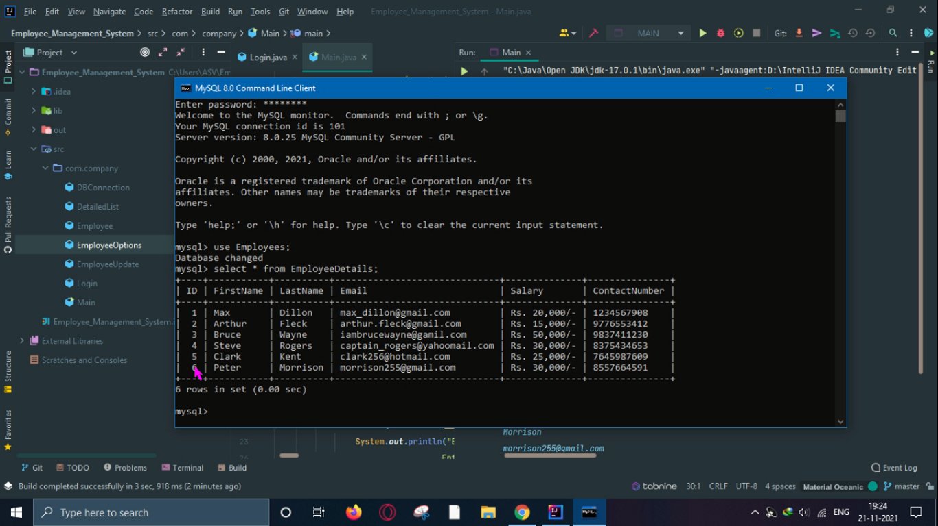
Employee Management System
Add new Employee

Slide 26
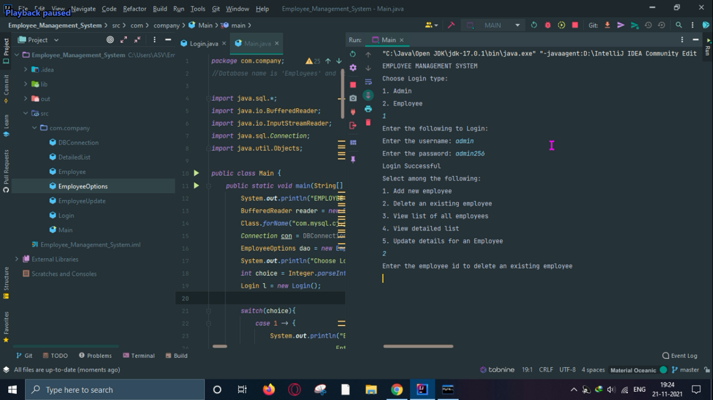
Employee Management System
Delete Employee

Slide 27
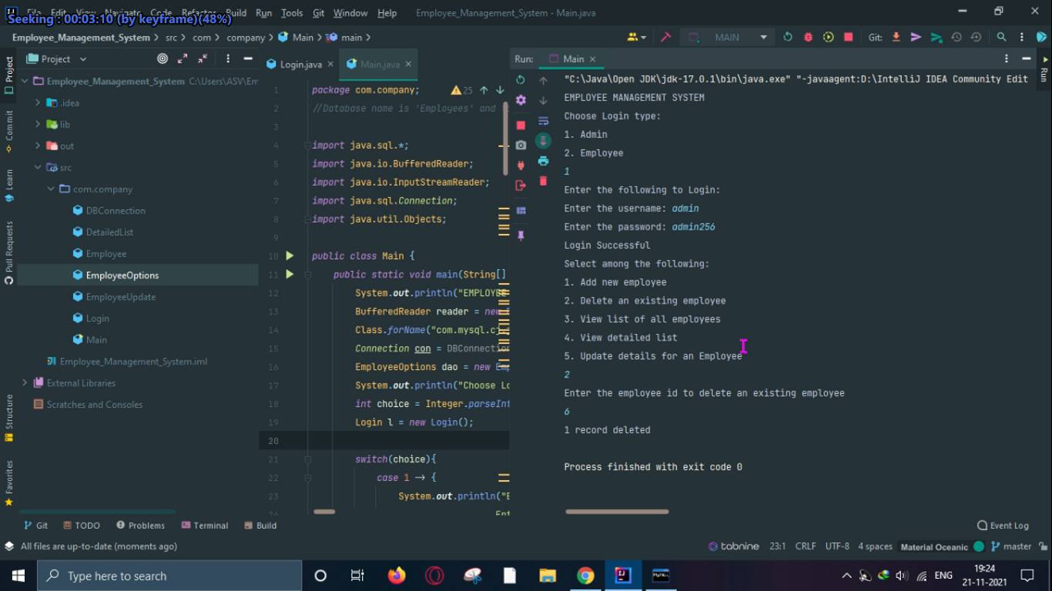
Employee Management System
Delete Employee

Slide 28
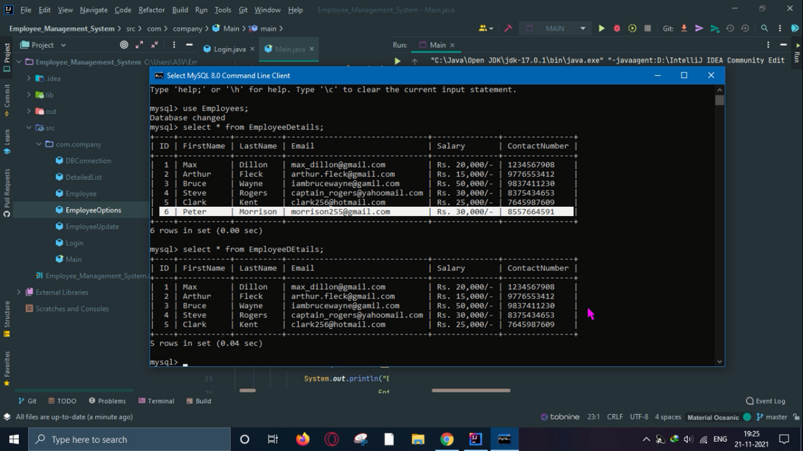
Employee Management System
Delete Employee

Slide 29
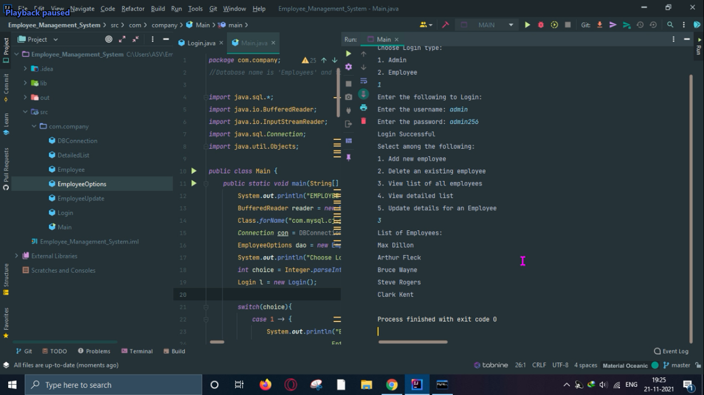
Employee Management System
View List of all Employees

Slide 30
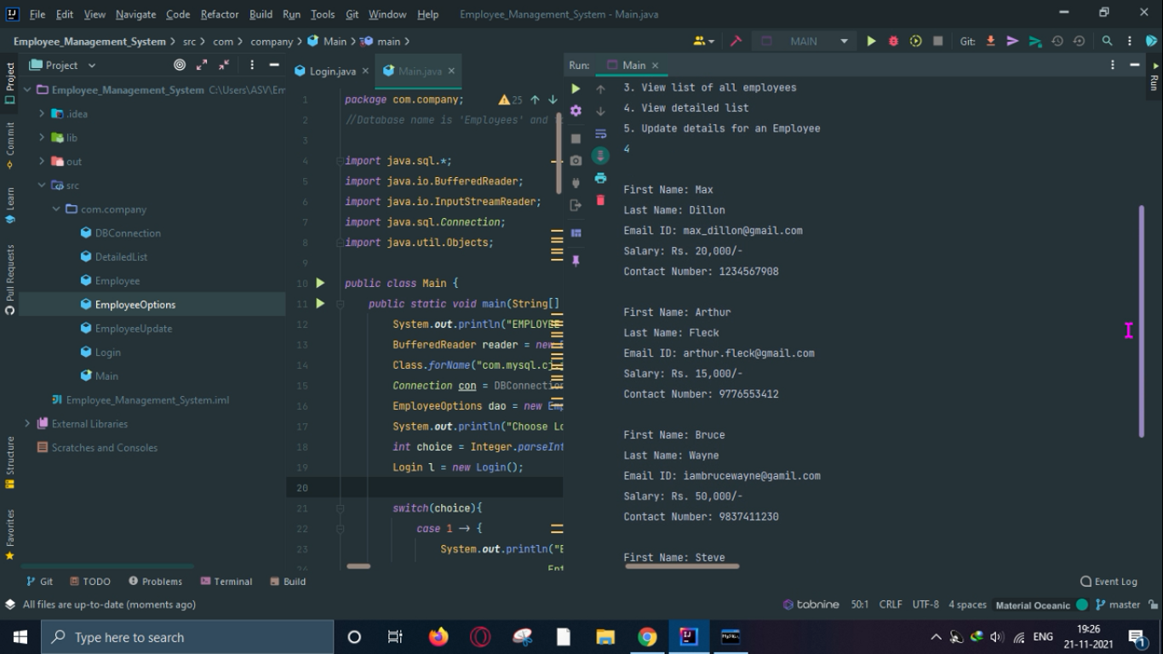
Employee Management System
View detailed list of all Employees

Slide 31
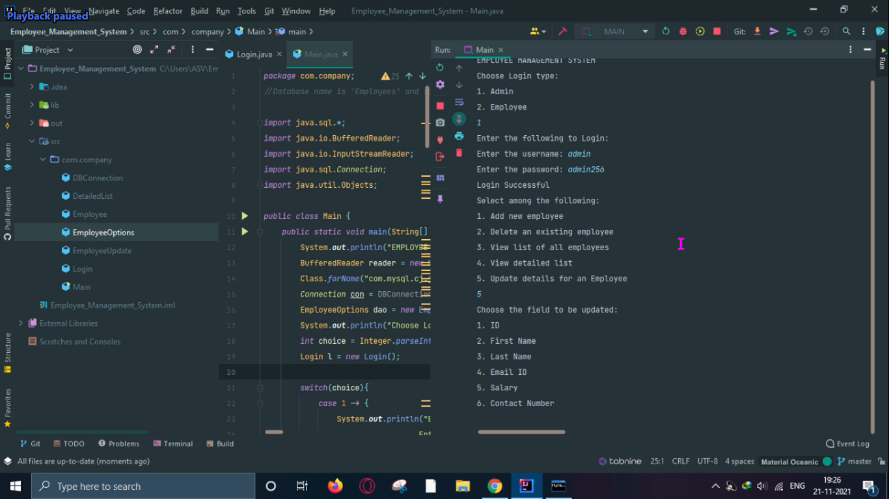
Employee Management System
Update Employee details

Slide 32
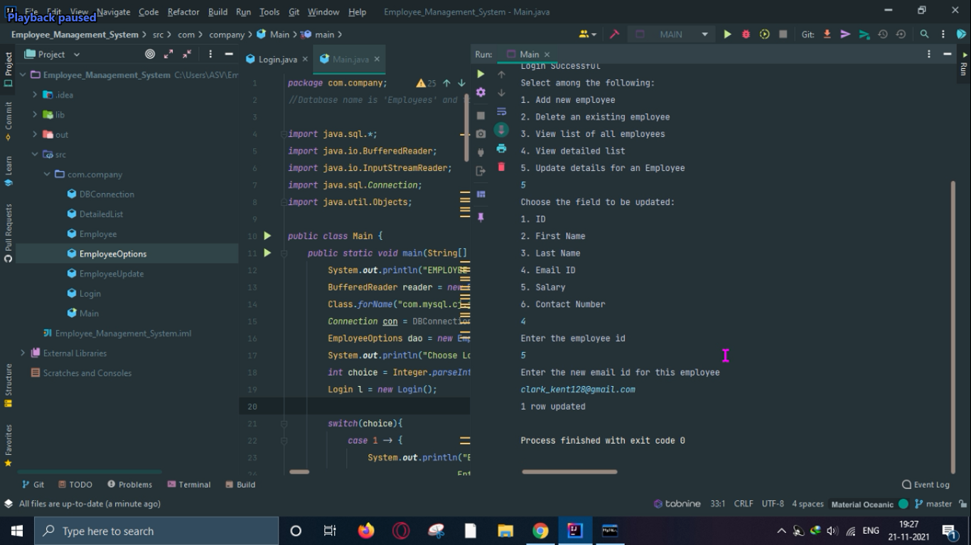
Employee Management System
Update Employee details

Slide 33
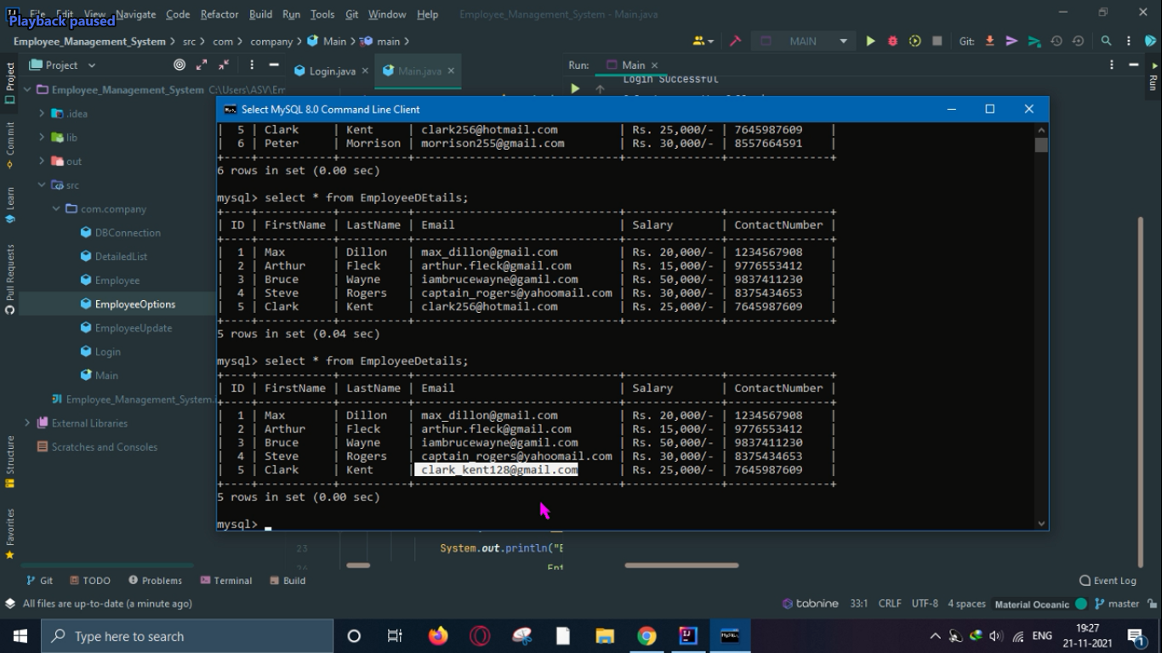
Employee Management System
Update Employee details

Slide 34
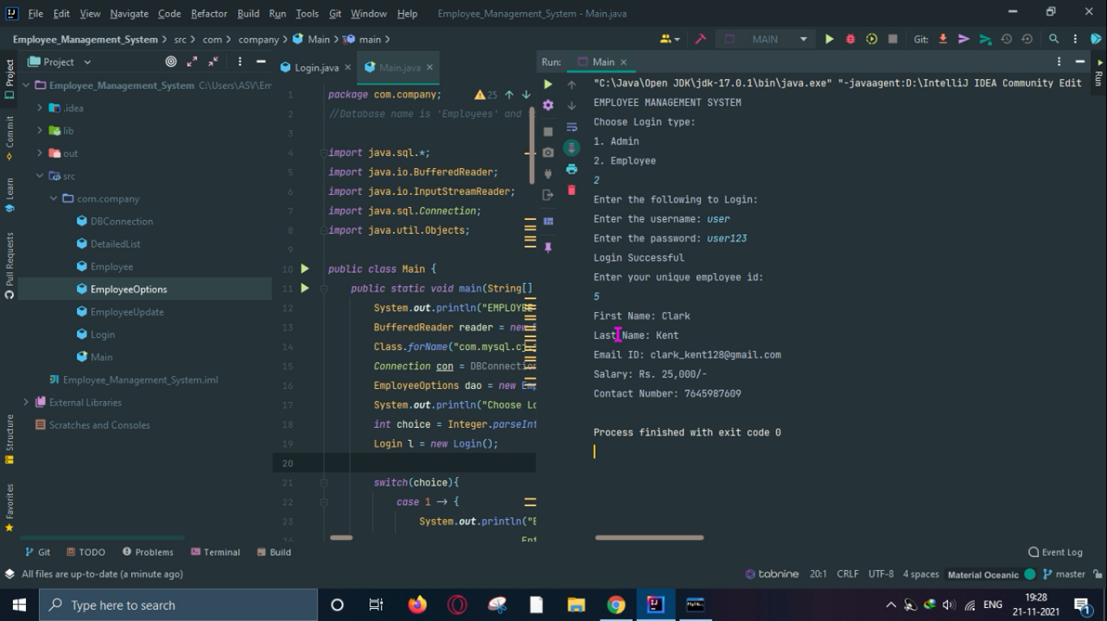
Employee Management System
Employee Login

Slide 35
Employee Management System Java Code Snippets

Slide 36
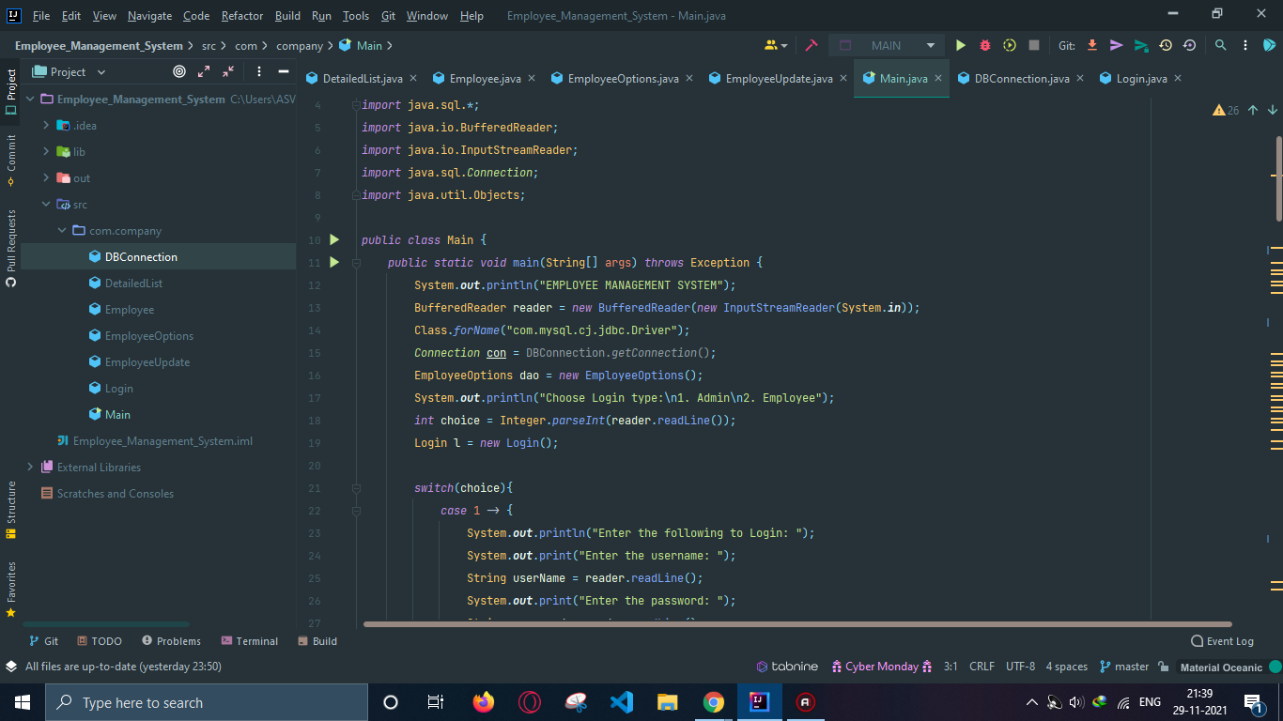
Employee Management System Code Snippet
Main

Slide 37
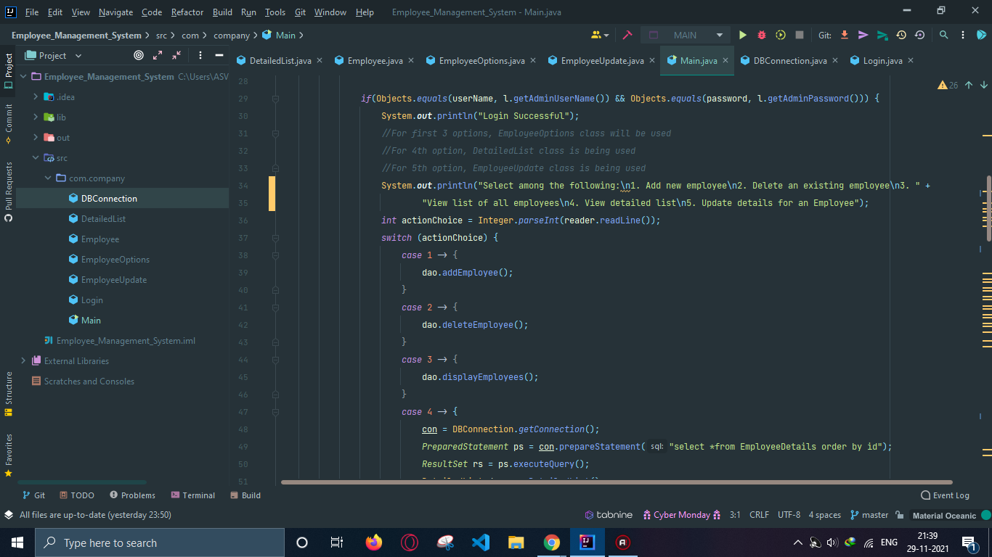
Employee Management System Code Snippet
Main

Slide 38
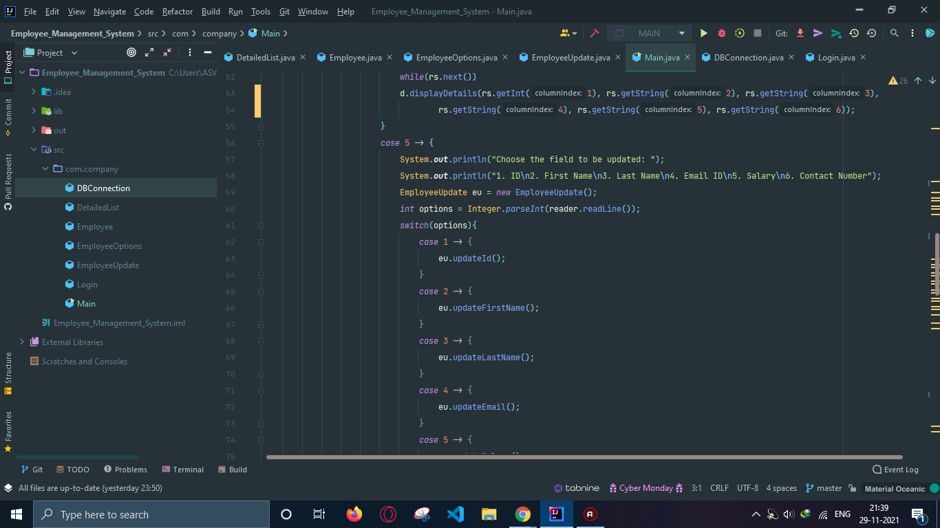
Employee Management System Code Snippet
Main

Slide 39
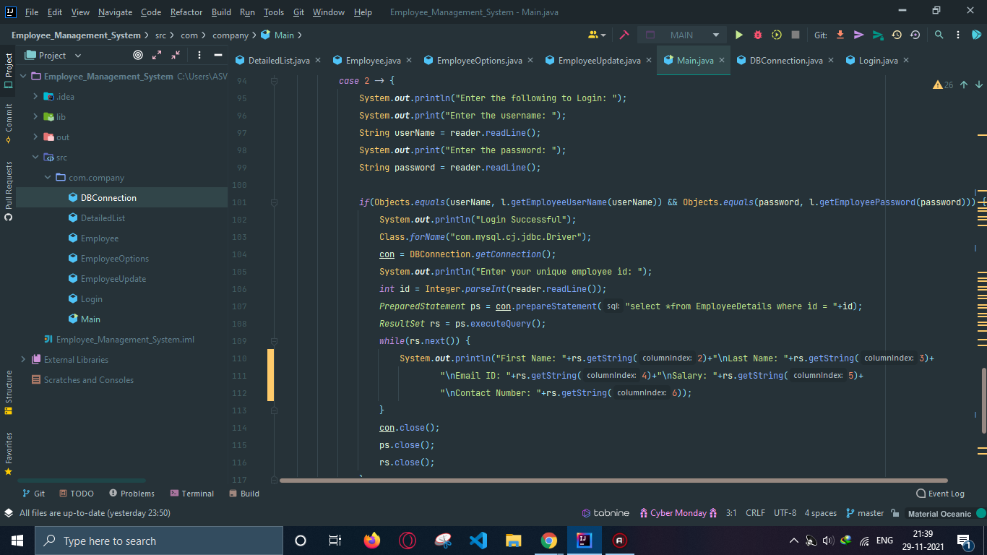
Employee Management System Code Snippet
Main

Slide 40
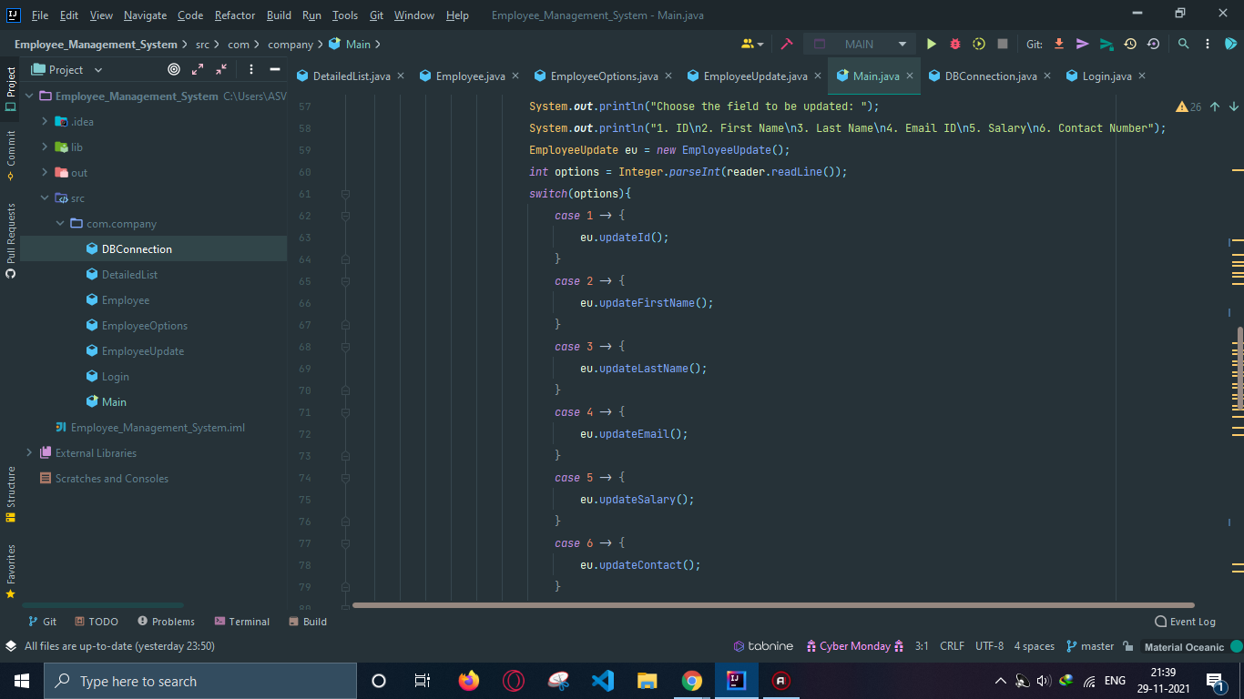
Employee Management System Code Snippet
Main

Slide 41
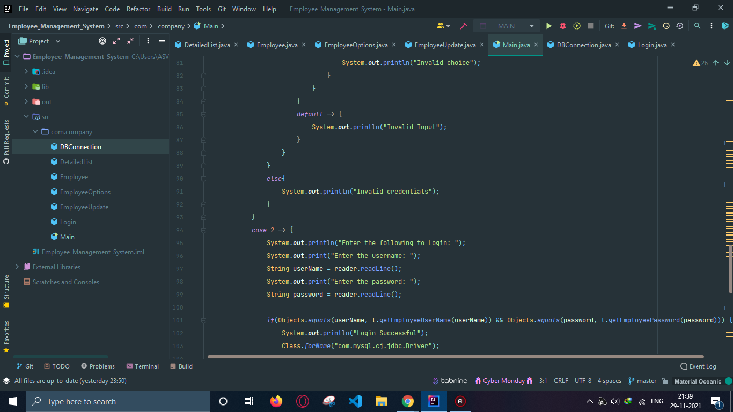
Employee Management System Code Snippet
Main

Slide 42
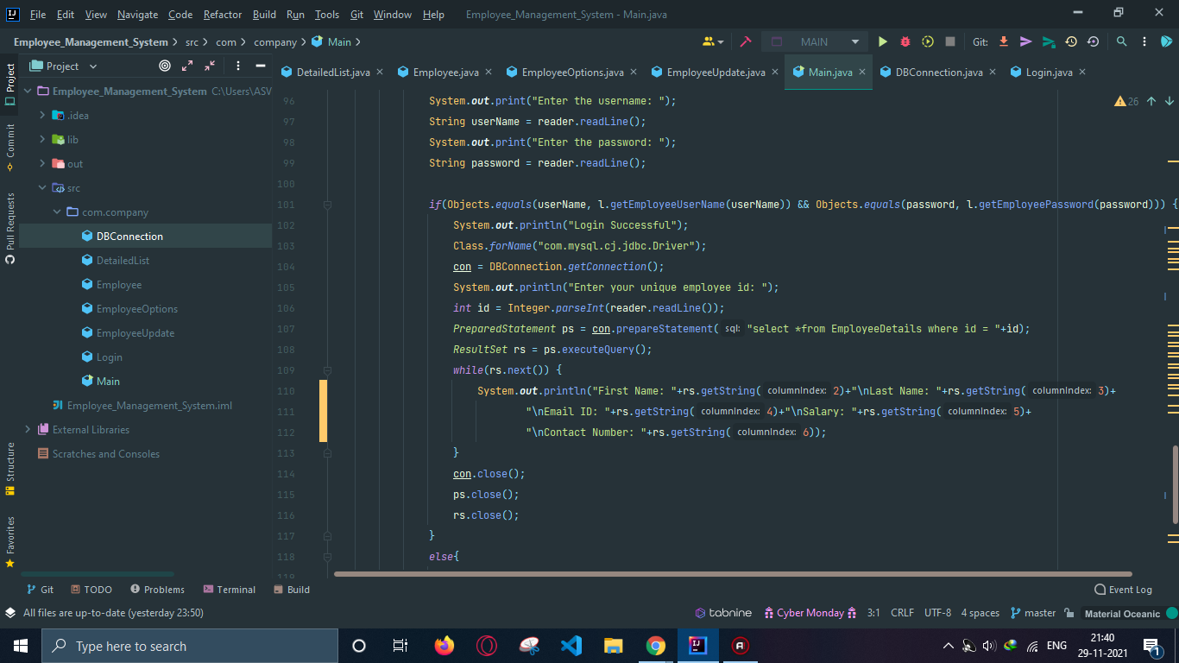
Employee Management System Code Snippet
Main

Slide 43
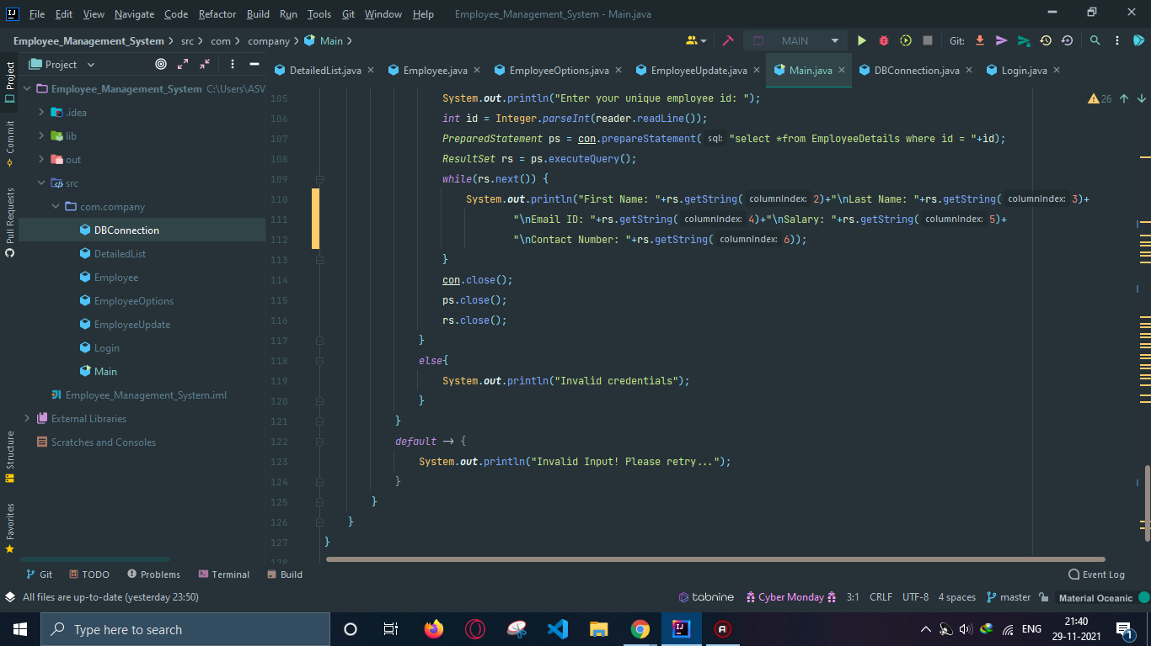
Employee Management System Code Snippet
Main

Slide 44
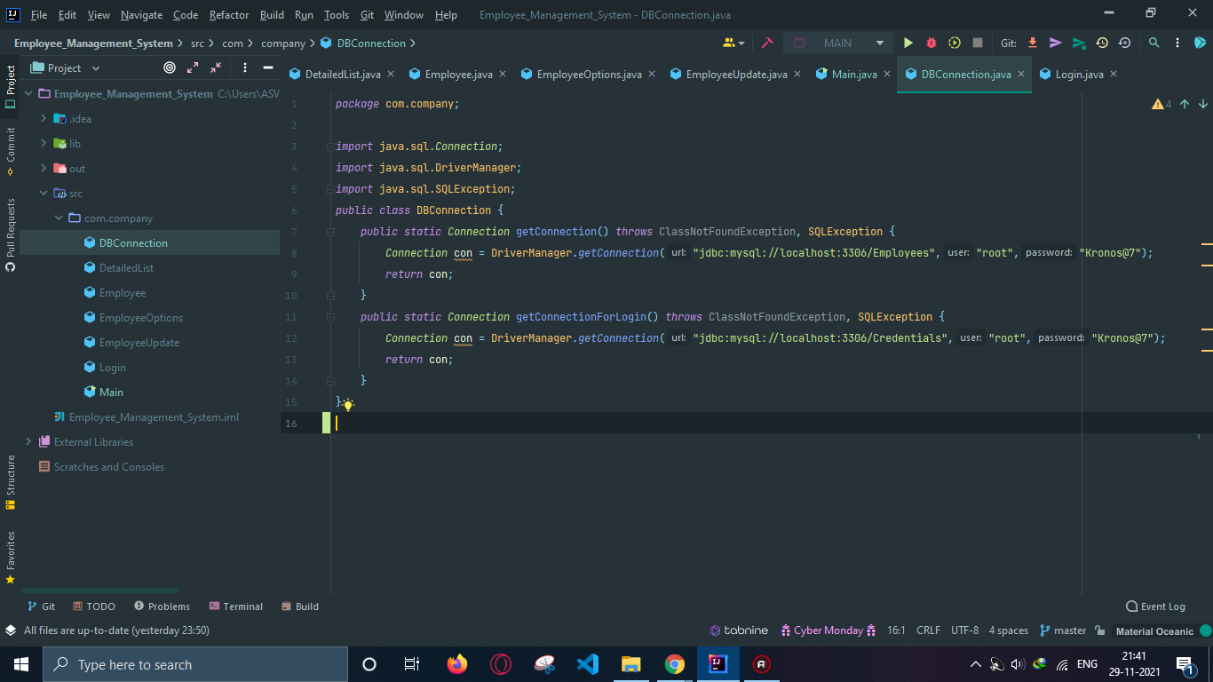
Employee Management System Code Snippet
DB Connection

Slide 45
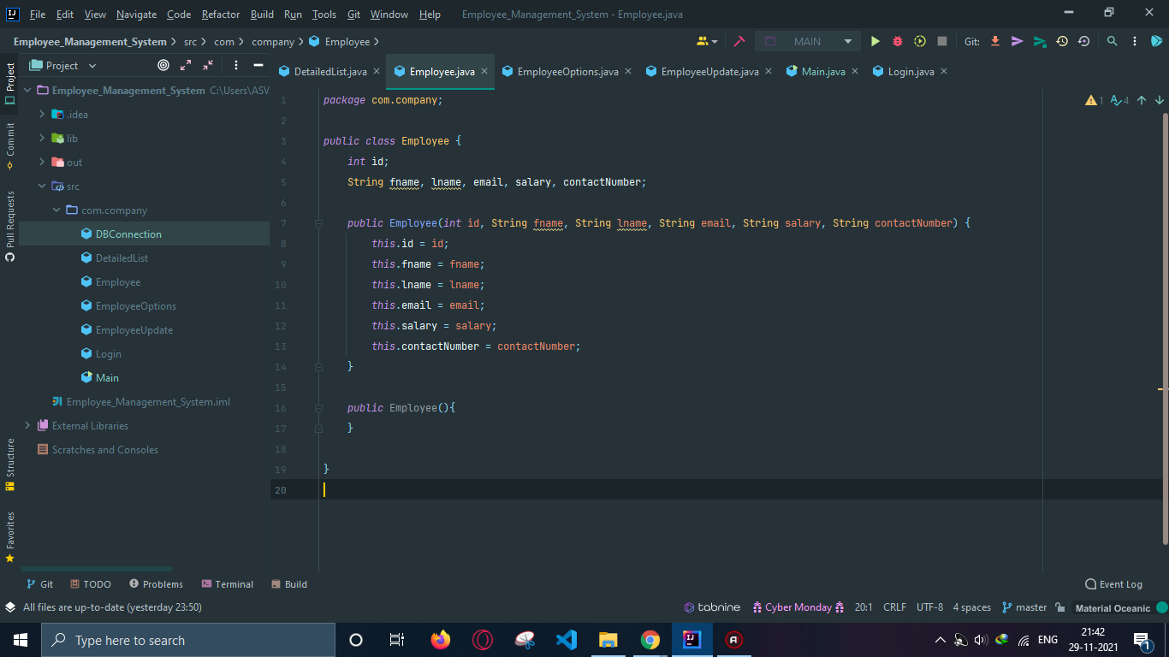
Employee Management System Code Snippet
Employee

Slide 46
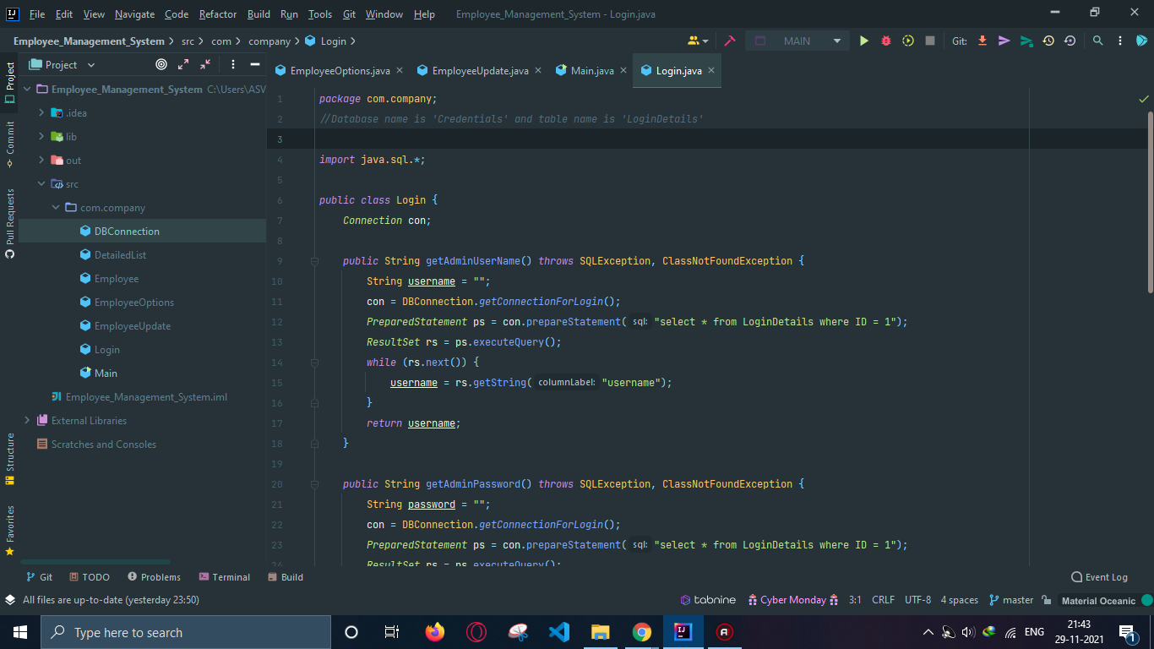
Employee Management System Code Snippet
Login

Slide 47
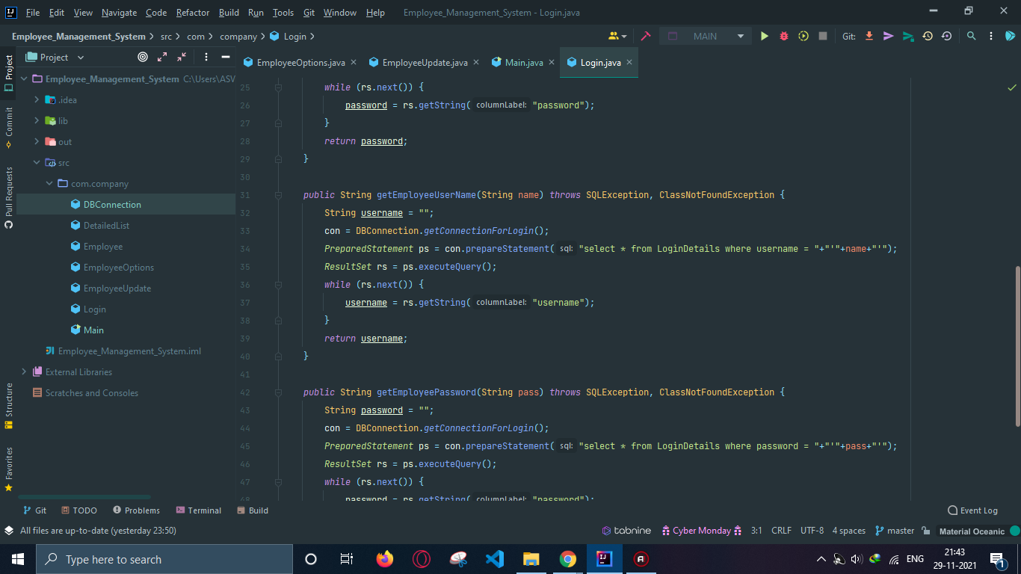
Employee Management System Code Snippet
Login

Slide 48
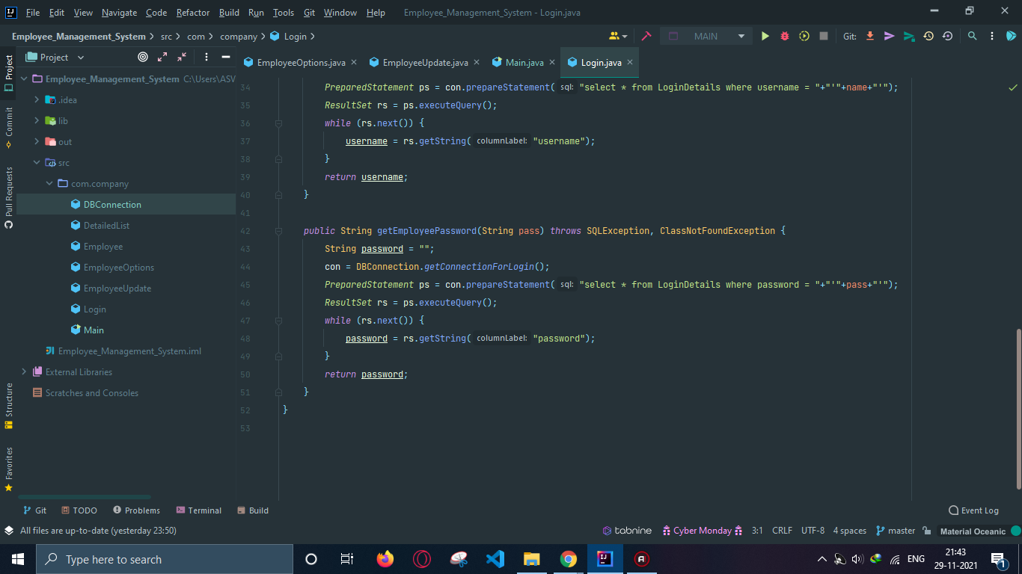
Employee Management System Code Snippet
Login

Slide 49
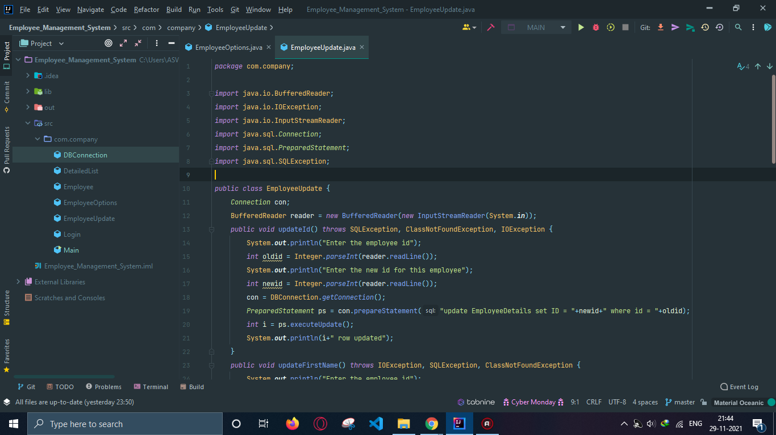
Employee Management System Code Snippet
Employee Update

Slide 50
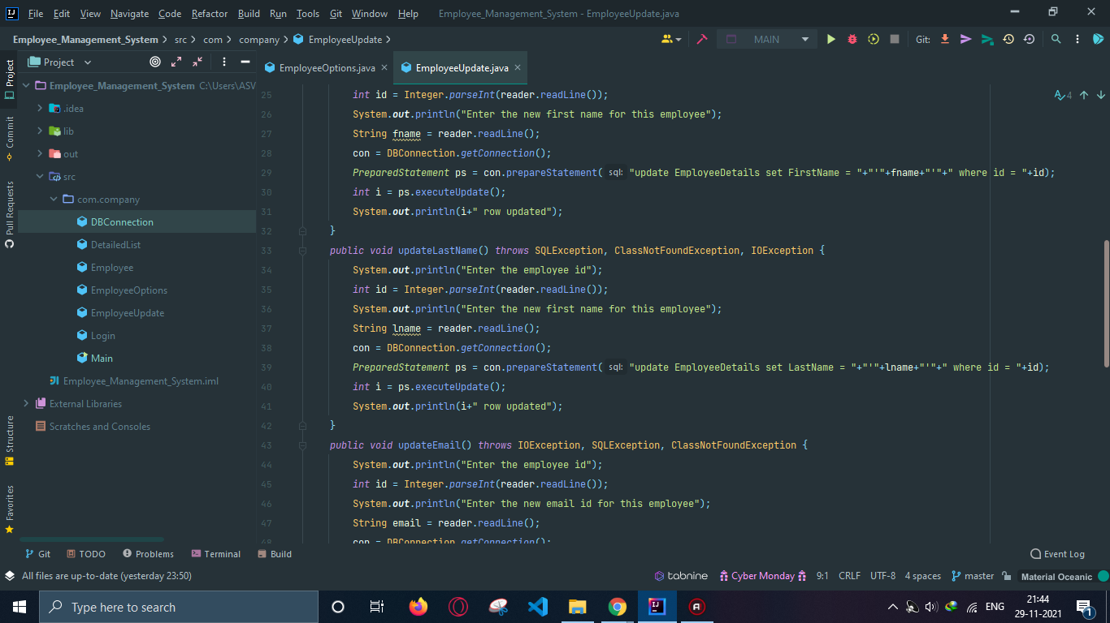
Employee Management System Code Snippet
Employee Update

Slide 51
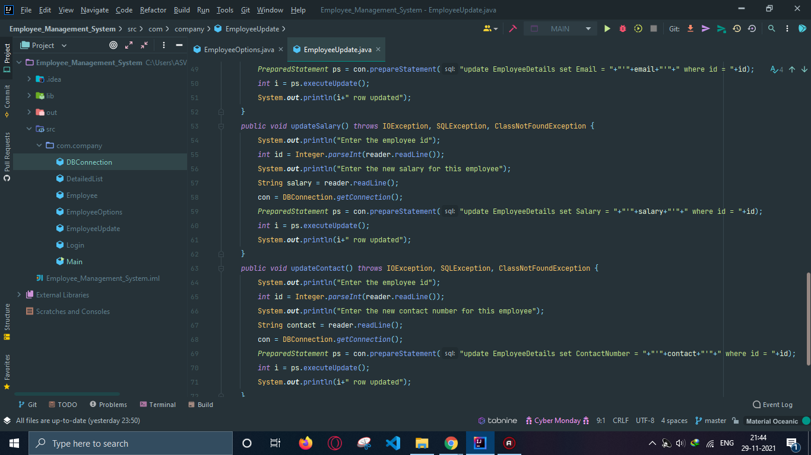
Employee Management System Code Snippet
Employee Update

Slide 52
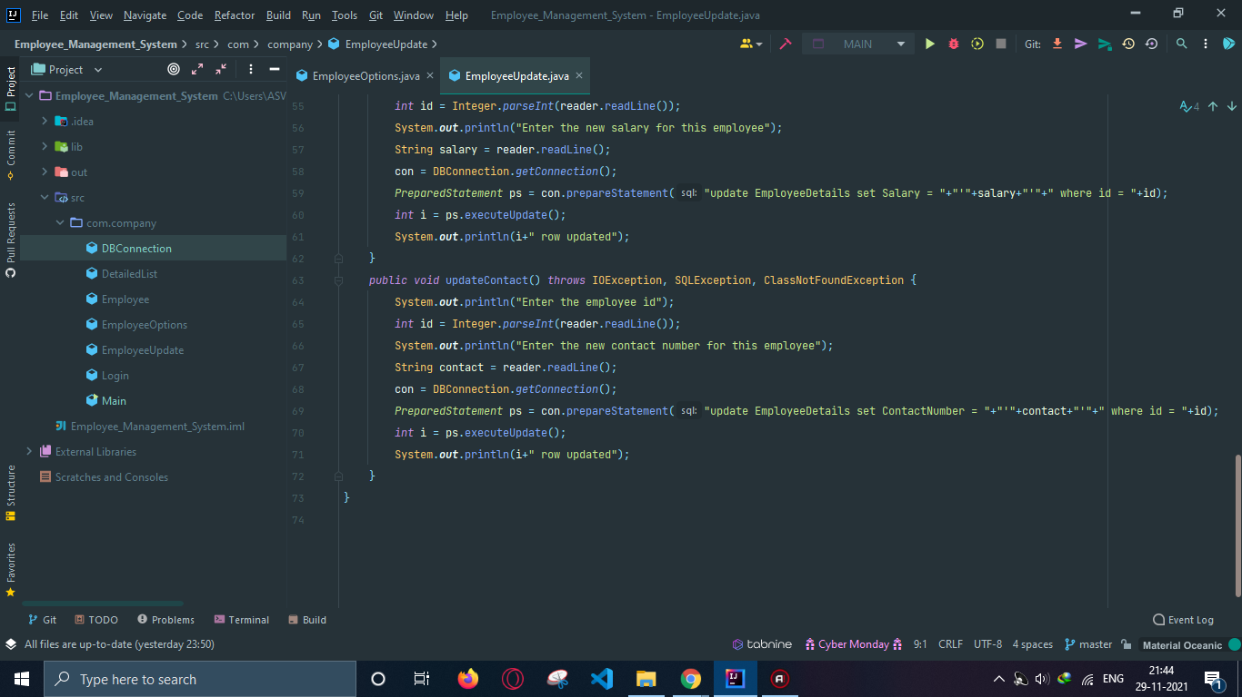
Employee Management System Code Snippet
Employee Update

Slide 53
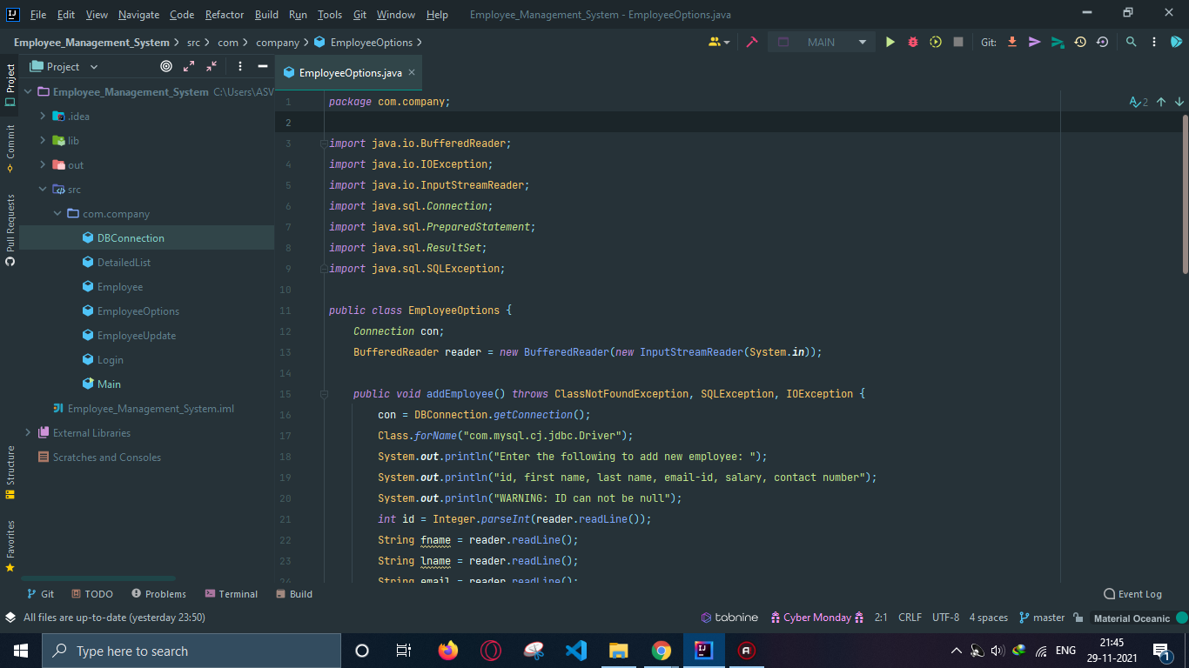
Employee Management System Code Snippet
Employee Options

Slide 54
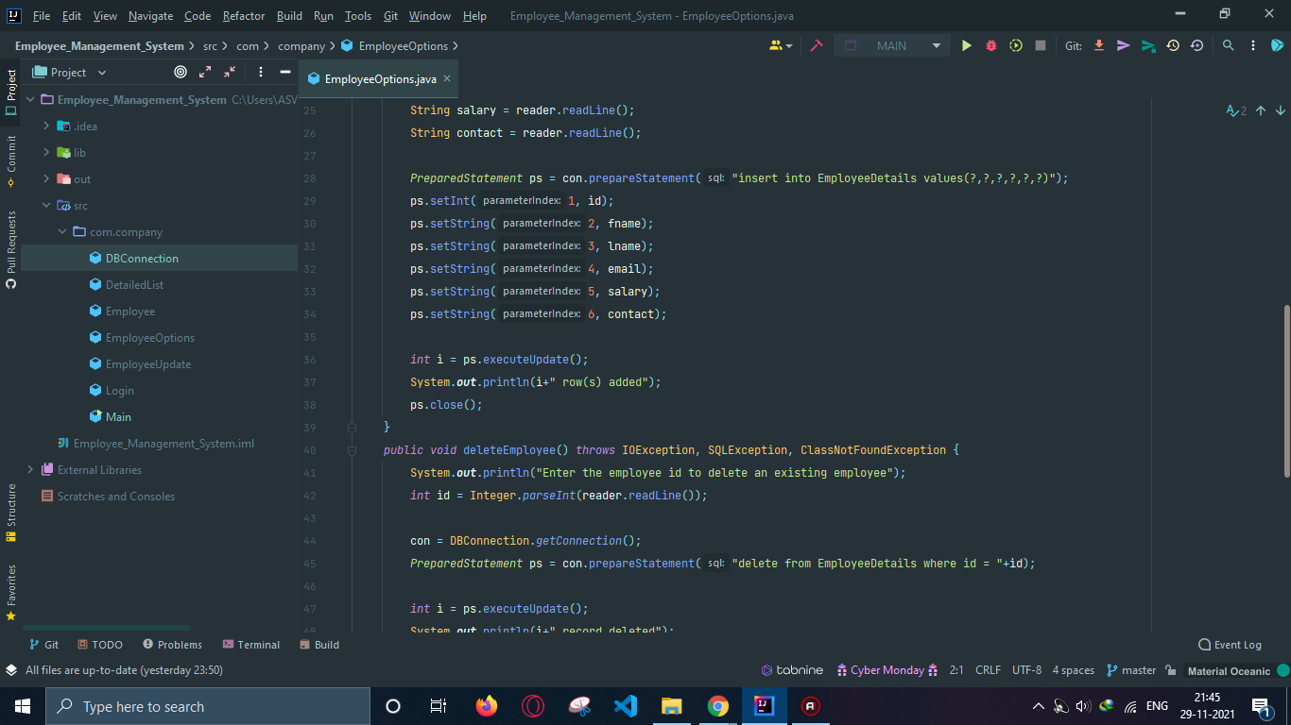
Employee Management System Code Snippet
Employee Options

Slide 55
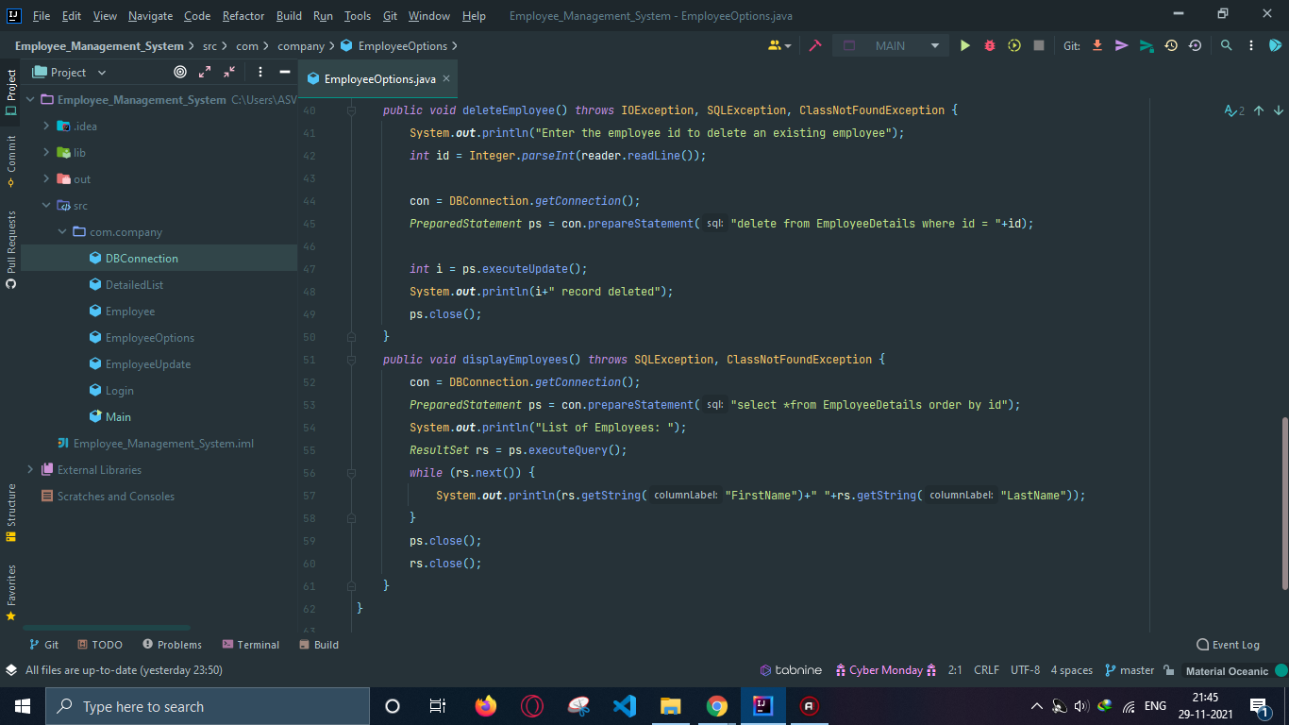
Employee Management System Code Snippet
Employee Options

Slide 56
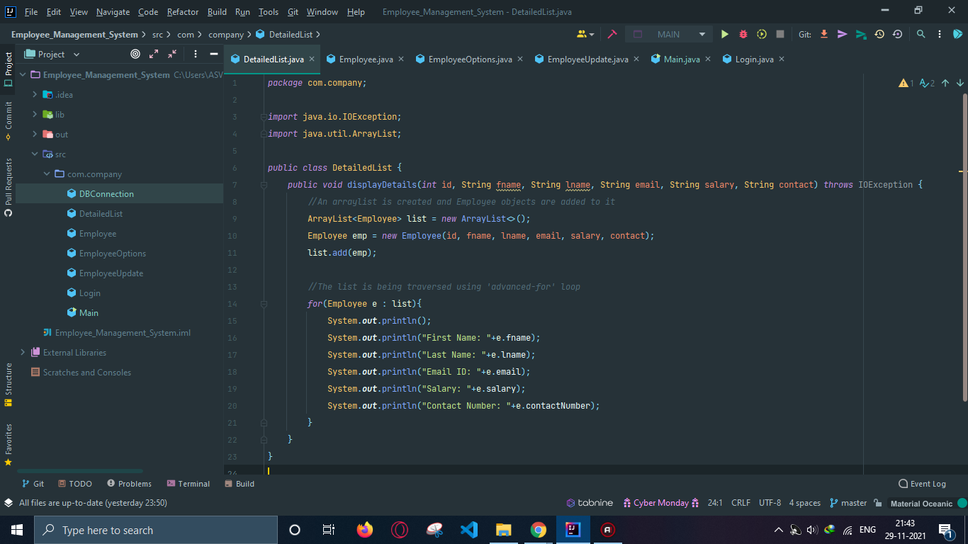
Employee Management System Code Snippet
Detailed List

Slide 57
Employee Management System Manual Test Cases

Slide 58
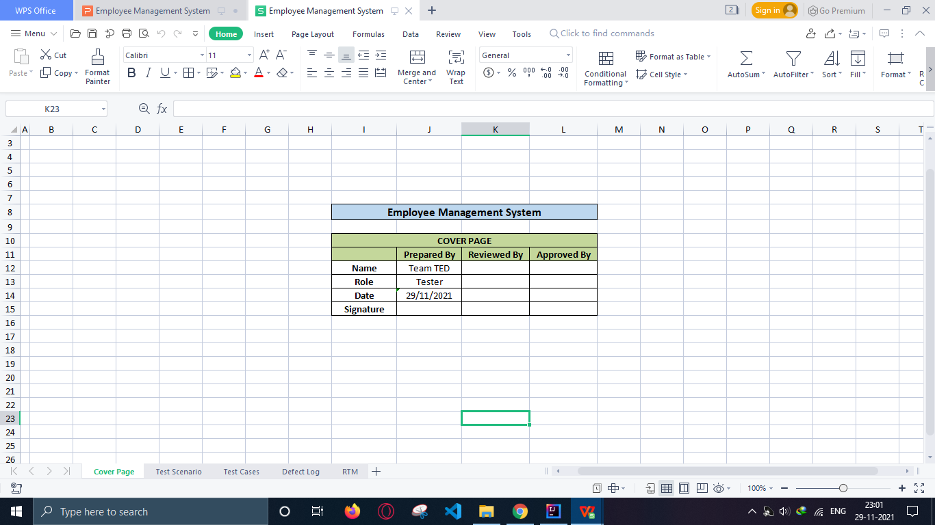
Test Case Documentation
Cover Page:

Slide 59
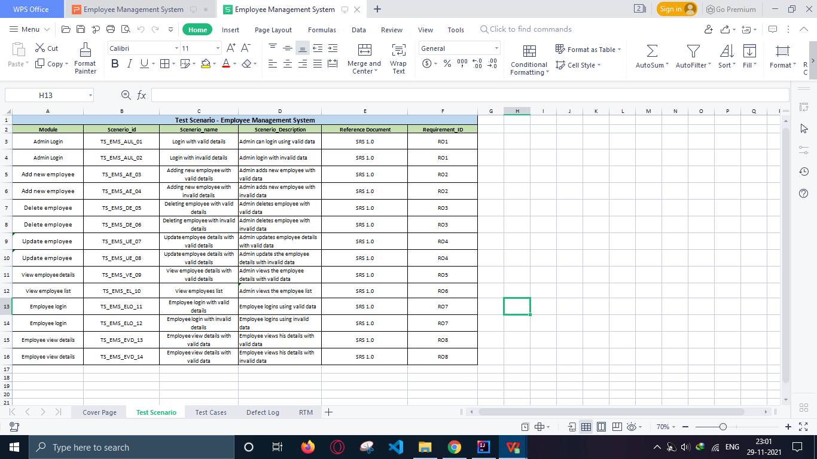
Test Case Documentation
Test Scenario:

Slide 60
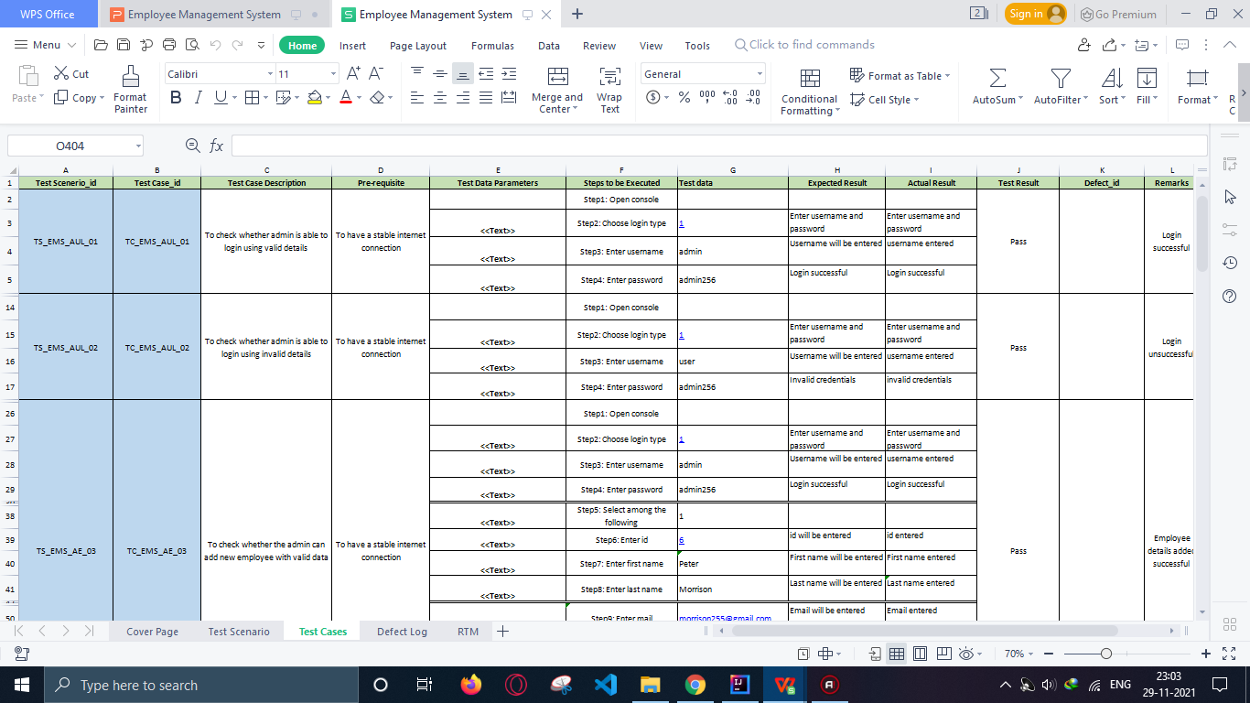
Test Case Documentation
Test Cases:

Slide 61
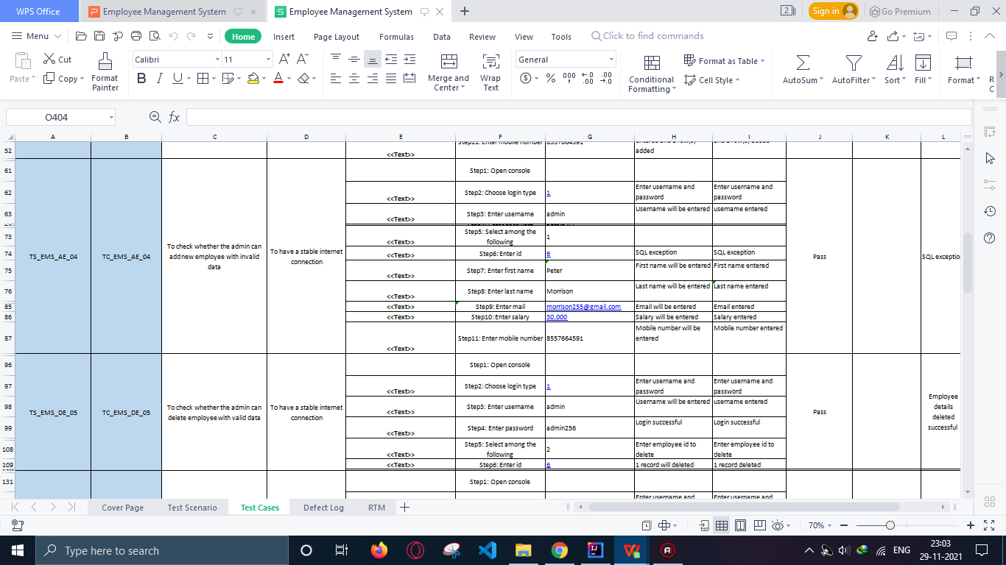
Test Case Documentation
Test Cases:

Slide 62
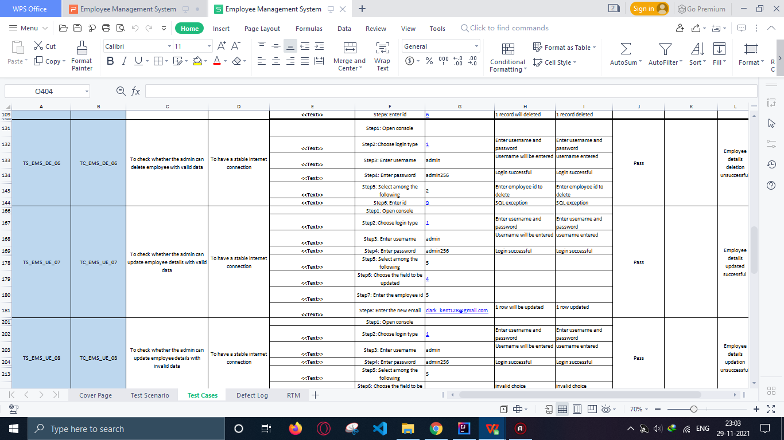
Test Case Documentation
Test Cases:

Slide 63
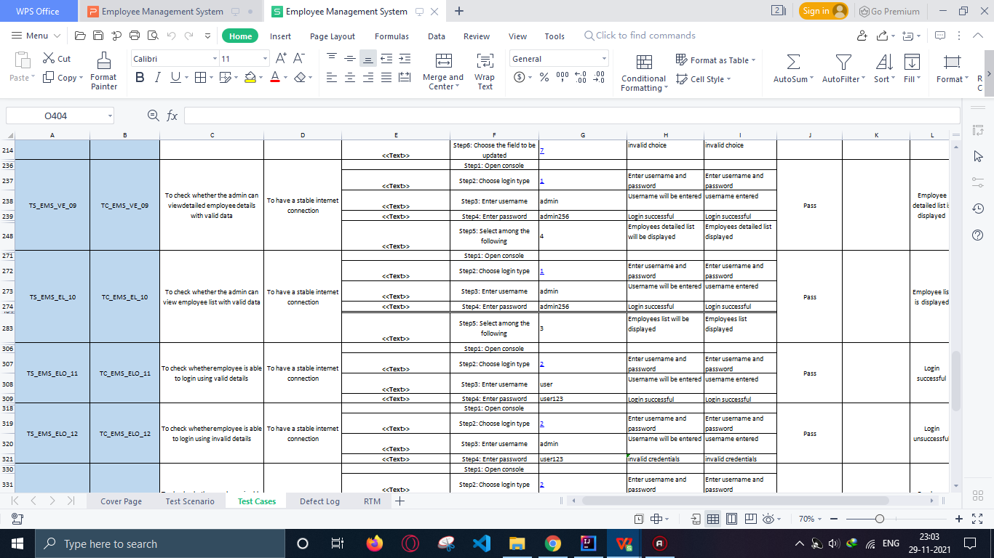
Test Case Documentation
Test Cases:

Slide 64
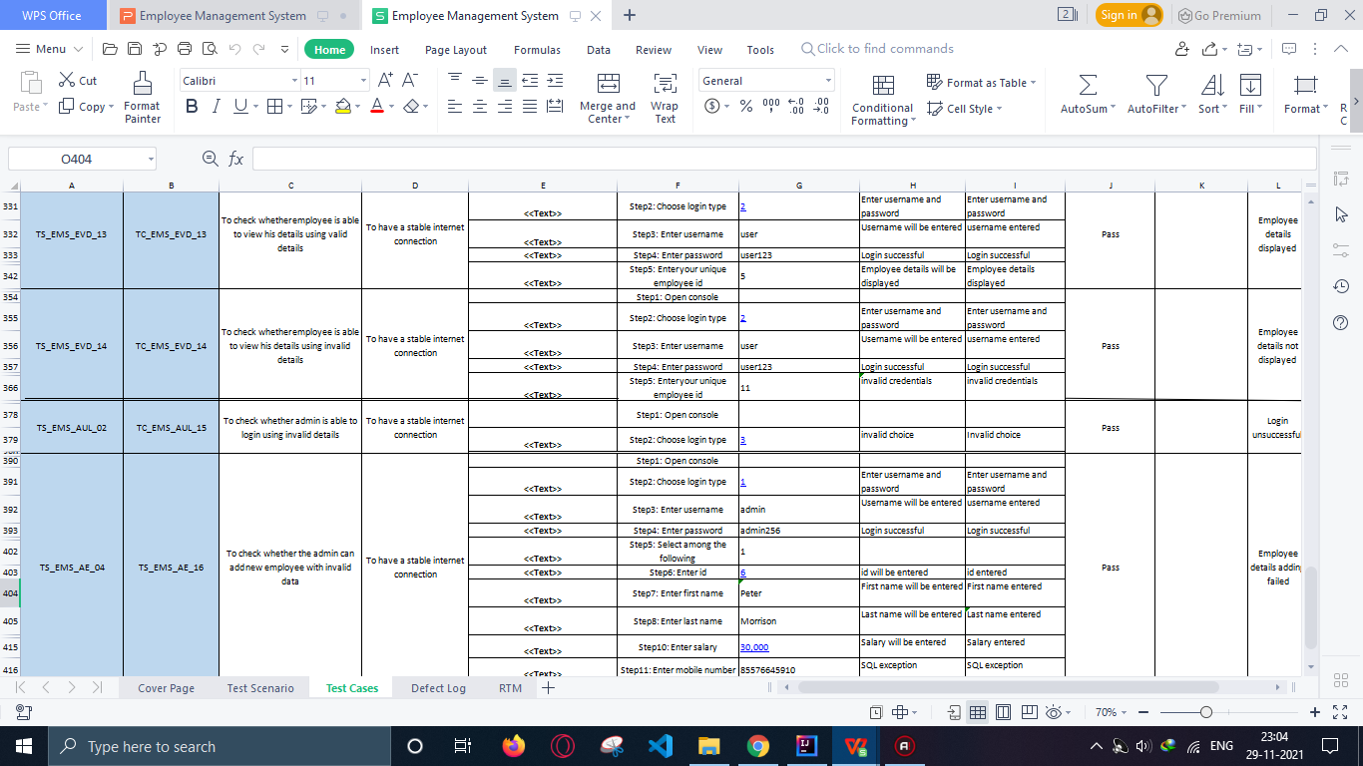
Test Case Documentation
Test Cases:

Slide 65
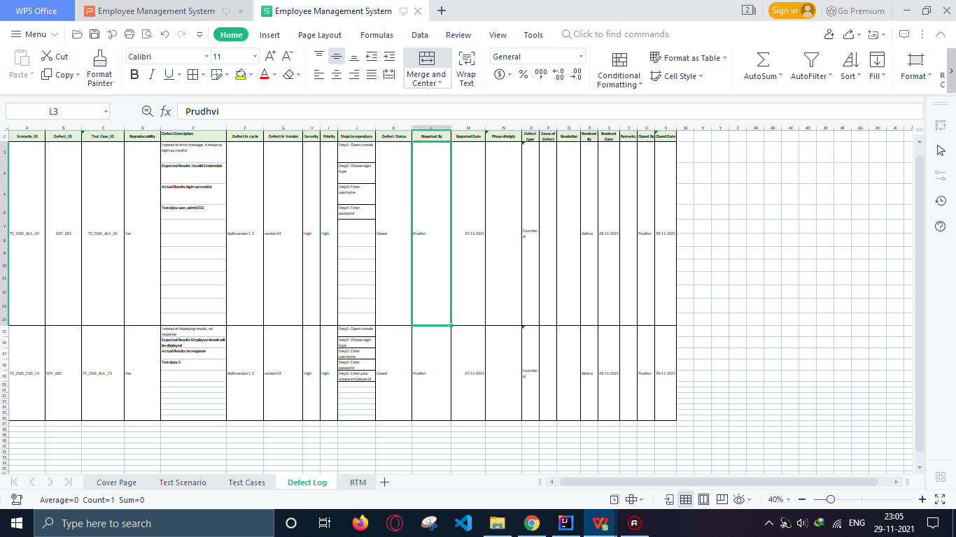
Test Case Documentation
Defect Log:

Slide 66
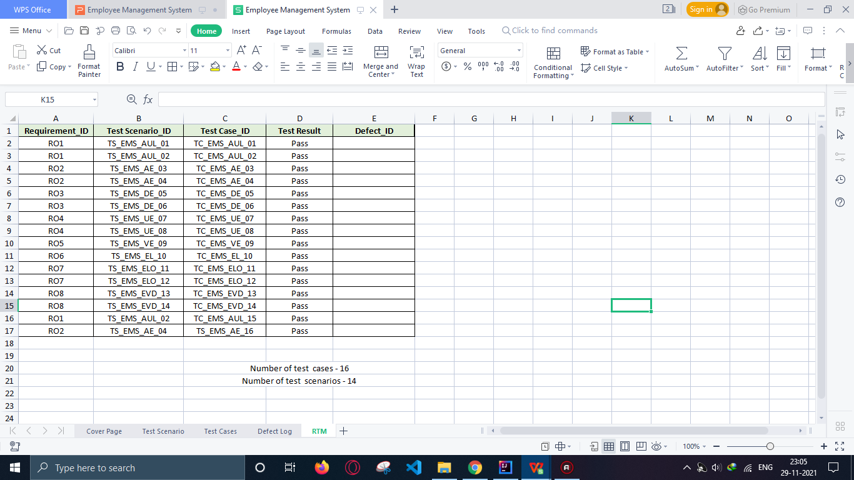
Test Case Documentation
RTM:

Slide 67
CONCLUSION
RESULTS
The software product produced was fairly good, it achieved most of the user requirements, the user interface is good and is very easy to navigate, and even novice users can find their way around the console easily. The client side validation is excellent.
GitHub Repository Link
https://github.com/asv520/Employee_Management_System

Slide 68
Future Work
Leave Management
The leave management module can be improved by having all leave requests approved by the head of department before submission rather than going straight to the HR manager. This feature is important because the Supervisor should know which of his/her employees which to go on leave.
Employee Performance
The designed system provides the admin with the ability to assign tasks to project members. If further worked on, this functionality can assist in determining the performance of employees based on their ability to finish tasks on time.

Slide 69
Automation Testing https://petstore.octoperf.com/

Slide 70
Introduction
Automation testing is a Software testing technique to test and compare the actual outcome with the expected outcome. This can be achieved by writing test scripts or using any automation testing tools like:
TestNg
Page Object Model(POM)
Data Driven Model

Slide 71
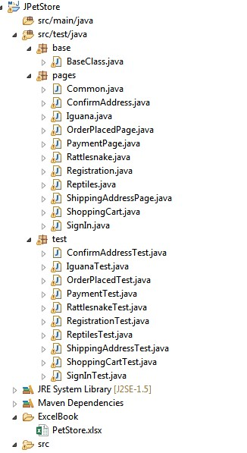

Packages and classes used:

Slide 72

Cross Browser Automation:

Slide 73

Cross Browser Automation:

Slide 74

Cross Browser Automation:

Slide 75


POM & Data Driven model

Slide 76

TestNg test results

Slide 77

TestNg test results

Slide 78

TestNg test report

Slide 79
CONCLUSION
GitHub Repository Link
https://github.com/asv520/Pet-Store-Automation

Slide 80

Thanks!
Any questions?

